Slide 1
CSCI2100E Binary Search Tree

Slide 2
Recap: Trees
13
13
Tree
Binary tree
Full binary tree
Complete binary tree
Max tree
Heap -> priority queue
10
9
8
10
9
7
5
4
2
4
1
An example of
a binary tree
An example of a tree
1
13
1
13
2
10
3
9
2
10
3
9
Max Heap: complete binary tree + max tree
4
5
6
7
4
5
6
4
3
1
5
4
3
1
An example of a
full binary tree
An example of a
complete binary tree

Slide 3
Searching on Binary Trees
Question: Find a node from a binary tree whose key is equal to searchnum
General binary tree
Need to traverse all nodes
How about heap?
Efficient in finding max/min
Searching for an arbitrary key?
Existing trees are inefficient for searching
Heap, max tree, binary tree

Slide 4
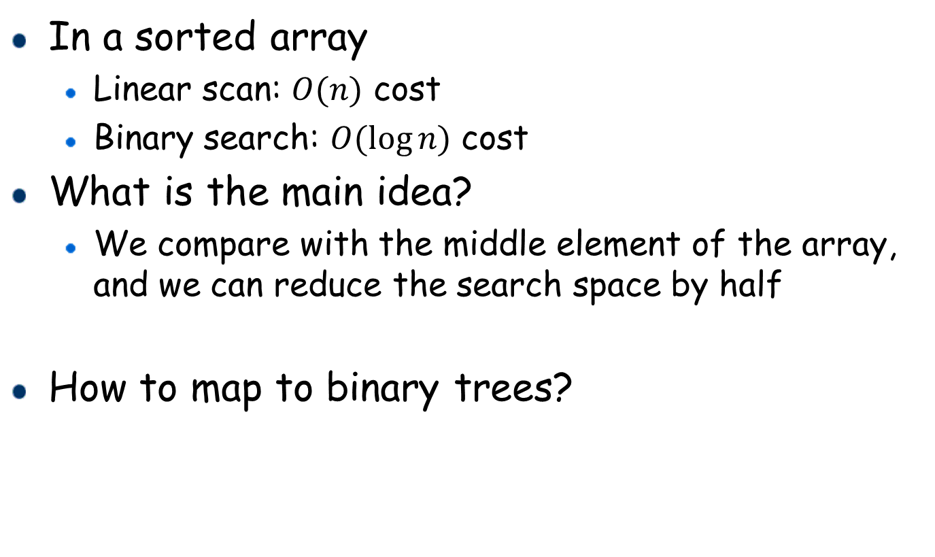
How Search May Become Efficient?
In a sorted array
Linear scan: $O(n)$ cost
Binary search: $O(\log{n)}$ cost
What is the main idea?
We compare with the middle element of the array, and we can reduce the search space by half
How to map to binary trees?

Slide 5
Binary Search Tree (BST)
A binary search tree is a binary tree which satisfies the following properties.
Every element has a unique key.
All keys in a nonempty left subtree must be smaller than the key in the root of the subtree.
All keys in a nonempty right subtree must be larger than the key in the root of the subtree.
12
12
20
20
5
4
12
22
12
25
3
4
3
5
10
15
25
10
15
22

Slide 6
Binary Search Tree Representation
C code
1
2
3
4
5
6
typedef struct _node{
struct node *left_child;
char data;
struct node* right_child;
}tree_node;
typedef tree_node * tree_pointer;
Using pointers
Why not arrays?
Consider the following binary search tree
(space inefficient
by arrays!)
44
32
29
28
26

Slide 7

Search in BST (search 25)
25 <44
44
Search Cost?
Depending on the height of the binary search tree.
Denote h as the height of the BST
Time complexity: $O(h)$
25 >17
17
88
25 <32
32
65
97
25 <28
28
82
29
76
No left child, return NULL
80

Slide 8
Search of a BST
Recursive search of a BST
tree_pointer search(tree_pointer root, int key)
{
if (!root) return NULL;
if (key == root->data) return root;
if (key < root->data)
return search(root->left_child, key);
return search(root->right_child, key);
}
Iterative search of a BST
tree_pointer search(tree_pointer tree, int key){
while (tree) { /* the root of a subtree is not empty */
if (key == tree->data) return tree;
if (key < tree->data) tree = tree->left_child;
else tree = tree->right_child;
}
return NULL;}

Slide 9
Print all values in a BST in order
Inorder traversal: first print the left subtree, and then the root, and then the right subtree.
Output: produce the list of values in ascending order
17 28 29 29 32 44 65 76 80 82 88 97
Question: how to produce the list in descending order?
44
17
88
32
65
97
Algorithm 3: Inorder(root)
1
2
3
4
if !isEmpty(root)
Inorder(Lchild(root))
print Data(root)
Inorder(Rchild(root))
28
82
29
76
80

Slide 10
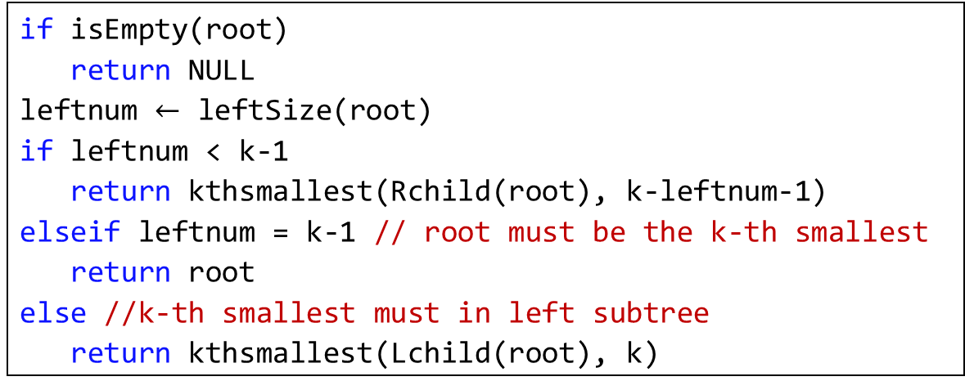

Practice
Finding the k-th ($k≥1$) smallest using binary tree ADT
with one more operation leftSize(bt tree) to return the number of nodes in the left child of the tree
If leftnum < k-1, the k-th smallest must exist in the right subtree. Then we only need to find the (k-leftnum-1)-th smallest from the right subtree
Algorithm 3: kthsmallest(root, k)
1
2
3
4
5
6
7
8
9
if isEmpty(root)
return NULL
leftnum $←$ leftSize(root)
if leftnum < k-1
return kthsmallest(Rchild(root), k-leftnum-1)
elseif leftnum = k-1 // root must be the k-th smallest
return root
else //k-th smallest must in left subtree
return kthsmallest(Lchild(root), k)

Slide 11
Insertion of BST
No duplicate in the binary search tree
We need to do search first
Where to insert?
After insertion, we should not violate the constraint
Insert in the right subtree of node 30
30
30
Insert in the left subtree of node 30
30
5
40
5
40
5
40
2
15
80
2
15
80
2
15
35
80
Insert 35

Slide 12
Search the Point (for Insertion)
Search the point in the tree to insert a key calling a procedure called searchPoint.
If the tree has the key, searchPoint returns NULL.
This implies that we do not need to insert the key into the tree.
If the tree does not have the key, searchPoint returns the parent node as the point under which the key should be inserted as its child.

Slide 13
Insert into a BST
Insert key into a BST tree identified by the root.
Call searchPoint to get the point under which the key is to be inserted.
If the root is NULL, create a new node to keep the key.
If the root is not NULL then
Create a node ptr to keep the key.
Compare the key held by the point and the key to be inserted.
If the former is larger, insert ptr as the left child of the point. Otherwise, insert ptr as the right child of the point.

Slide 14
searchPoint
tree_pointer searchPoint(tree_pointer root, int key)
{
if (!root) return NULL; /* empty tree */
if (key == root->data) return NULL; /* root is the node */
/* key is smaller than the node and there is left subtree */
if ((key < root->data) && (root->left_child))
return searchPoint(root->left_child, key);
/* key is larger than the node and there is right subtree */
if ((key > root->data) && (root->right_child))
return searchPoint(root->right_child,key);
return root; /* question: why do we need to return root? */
/* the node when the search terminates */
/* i.e. the place to insert the key */
}

Slide 15
insert
void insert(tree_pointer root, int key)
{ /* do nothing if key is already in the tree */
tree_pointer ptr, point;
point = searchPoint(root, key);
if (point || !(root)) { /* point != NULL → key is not in the tree */
ptr = (tree_pointer)malloc(sizeof(*node));
ptr->data = key;
ptr->left_child = ptr->right_child = NULL;
if (root) /* the tree exists, insert as child of point */
if (key < point->data) point->left_child = ptr;
else point->right_child = ptr;
else root = ptr; /* it is the first node in the tree */
/* insert the node as the root node for an empty tree */
}
}

Slide 16
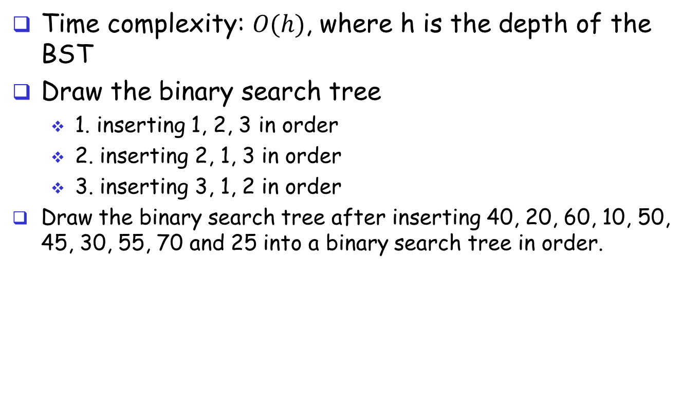
Practice
Time complexity: $O(h)$, where h is the depth of the BST
Draw the binary search tree
1. inserting 1, 2, 3 in order
2. inserting 2, 1, 3 in order
3. inserting 3, 1, 2 in order
Draw the binary search tree after inserting 40, 20, 60, 10, 50, 45, 30, 55, 70 and 25 into a binary search tree in order.
40
20
60
10
30
50
70
25
45
55

Slide 17
Deletion of BST
Three cases
Case 1: delete a leaf node
Case 2: delete a node with only one child
Case 3: delete a node with two children
30
30
30
5
40
5
40
5
40
2
15
80
2
15
80
2
15
80
13
16
13
16
13
16
delete 80
delete 40
delete 5

Slide 18
Deletion of BST: Cases 1 and 2
Case 1: delete leaf node
If right (resp. left) child, just set the right (resp. left) child of its parent to NULL
Case 2: delete a node with a single child
Put the single child at the place of the deleted
30
30
30
5
40
5
80
5
40
2
15
80
2
2
15
80
15
13
16
13
16
13
16
delete 80
delete 40
After deletion

Slide 19
Deletion of BST: Case 3
Case 3: delete a node with two children
We should replace a node here. But which node to put here?
The smallest node in the right subtree (successor)
E.g., the smallest node in the right subtree of node 5 is node 13
30
30
Replace with successor
delete 13 from the right subtree
30
5
40
13
40
13
40
2
15
80
2
15
80
2
15
80
13
16
13
16
16
delete 5

Slide 20
Practice
40
Delete 10 from the above tree
Delete 30 from the above tree
Delete 60 from the above tree
20
60
10
30
50
70
25
45
55

Slide 21
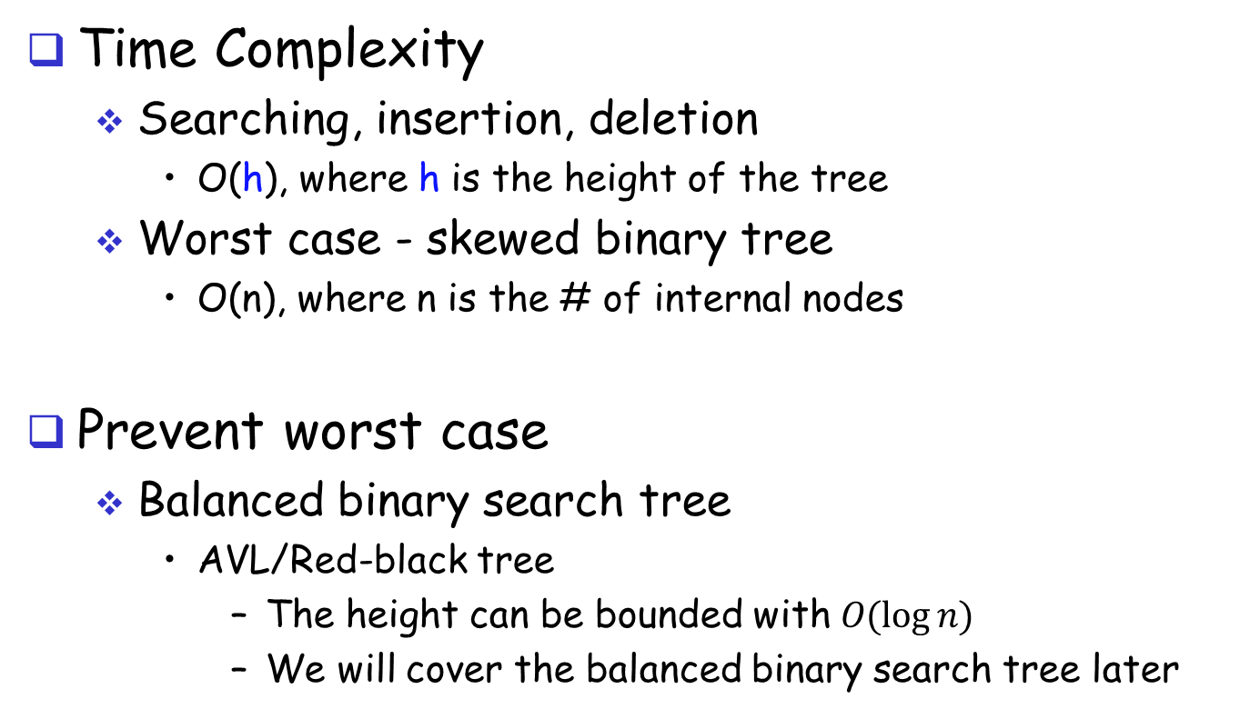
Complexity analysis
Time Complexity
Searching, insertion, deletion
O(h), where h is the height of the tree
Worst case - skewed binary tree
O(n), where n is the # of internal nodes
Prevent worst case
Balanced binary search tree
AVL/Red-black tree
The height can be bounded with $O(\log{n)}$
We will cover the balanced binary search tree later

Slide 22
Summary
binary search tree (BST)
Definition of BST
Search/insertion/deletion

